Slide 1
ECE499 Thesis Progress Update
Daniel Yu
January 7th, 2026

Slide 2
Outline
Problem Statement & Objective
Methodology
Preliminary Results
Next Steps & Timeline

Slide 3
Problem Statement & Objective
Core Problem:
To design and validate textile EEG electrodes that can achieve clinically acceptable signal quality while improving usability
Current Limitations:
Wet EEG systems impractical for pediatric and long-duration use
Textile and dry electrodes remain insufficiently validated
Notes:
Limitations of Pediatric EEG Acquisition
Conventional wet EEG systems are impractical for pediatric and long-duration use due to discomfort from gel, lengthy setup, and sensitivity to motion.
Textile and dry electrodes offer improved wearability, but their signal quality, robustness, and performance over hair remain insufficiently validated.
There is a lack of standardized, repeatable validation frameworks—including anatomically realistic head phantoms—for comparing emerging EEG sensor materials against medical-grade gold standards.
Consequently, the design trade-offs between comfort, manufacturability, and signal fidelity in pediatric EEG systems are not well understood.
Core Problem: How to design and rigorously validate multichannel pediatric EEG sensors—particularly textile-based electrodes—that achieve clinically acceptable signal quality while improving usability.
Sub-objectives to explore pre-amplifier design

Slide 4
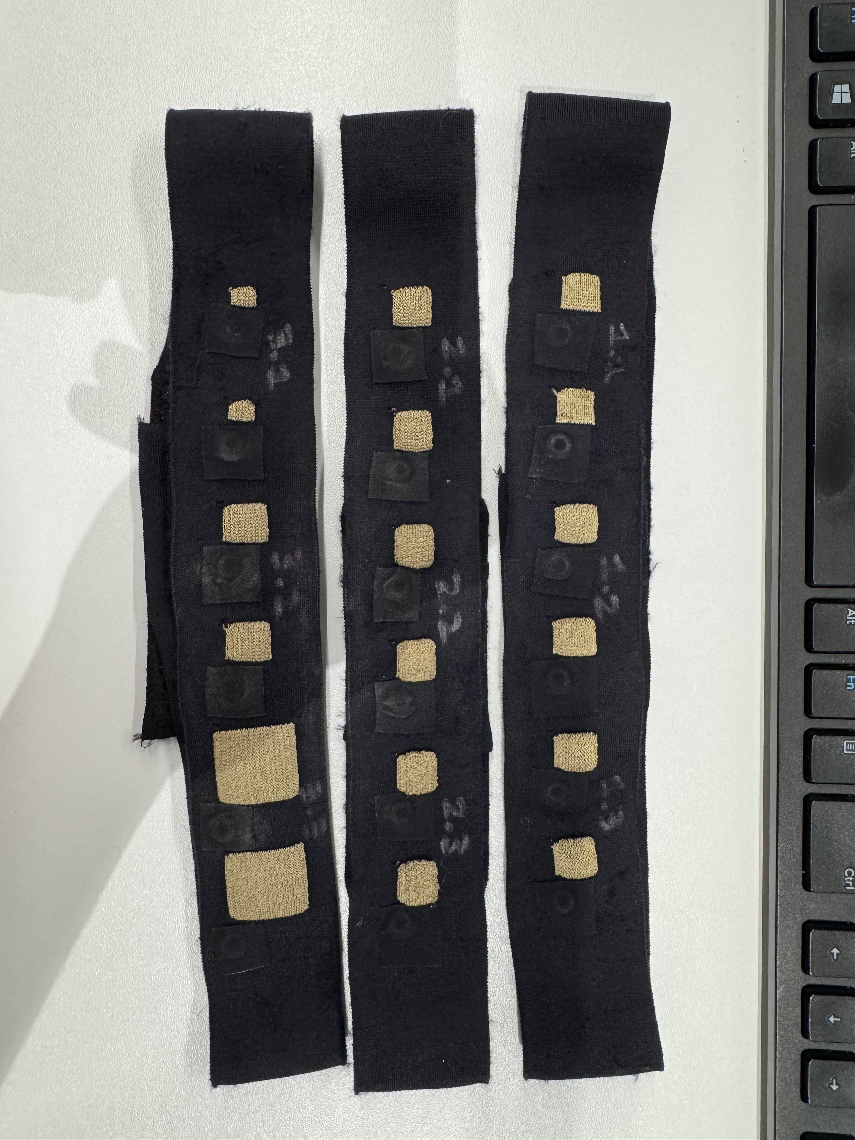
Methodology
Raised Height (1.1-1.3)
1mm, 2mm, 3mm
Silver Density (2.1-2.3)
1x, 1.5x, 2x
Area Size (3.1-3.3)
0.5cm, 1.0cm, 2.0cm
Notes:
- 1.0 --> Raised Height (1x density)
- 1.1: 1 mm
- 1.2: 2 mm
- 1.3: 3 mm
- 2.0 --> Silver Density (2mm height)
- 2.1: least dense (1x)
- 2.2: moderately dense (1.5x)
- 2.3: most dense (2x)
- 3.0 --> Area Size (1x density, 2mm height)
- 3.1: ~0.5 x 0.5 cm
- 3.2: ~1.0 x 1.0 cm
- 3.3: ~2.0 x 2.0 cm
- Notes:
- All pad sizes are approximately 1.0 x 1.0 cm if not specified
- Need more precise quantitative measurables

Slide 5
Methodology
Comparison between dry BrainProduct electrodes and textiles electrodes at Fp1 and Fp2 positions
EEG data acquired using LiveAmp, Lab Recorder, and Mindset
Blink Test:
Movement artifacts
~200 seconds x 10 times
2 seconds per blink
Eyes Open/Closed:
Alpha band
10 seconds open/closed x 10 times

Slide 6
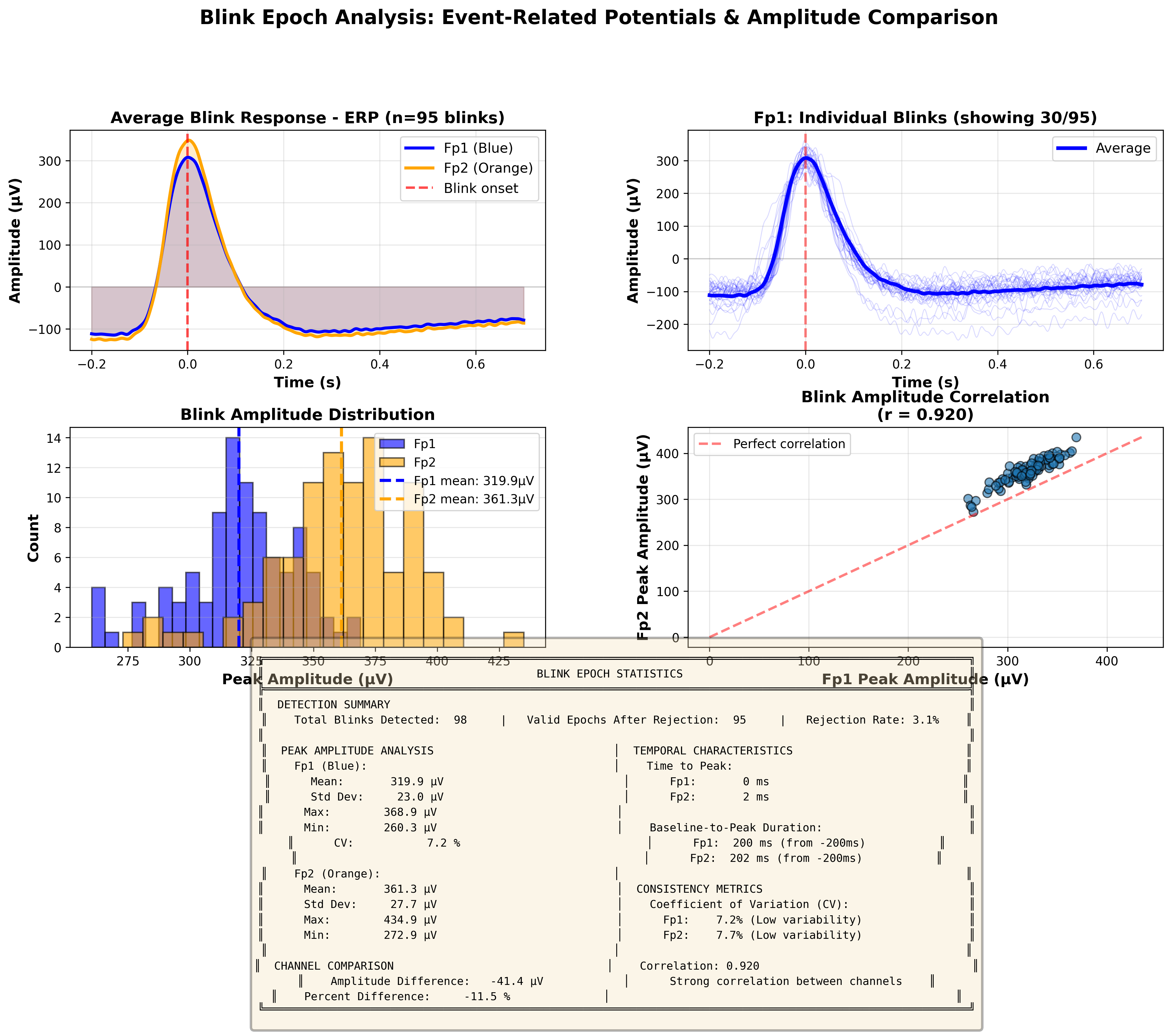
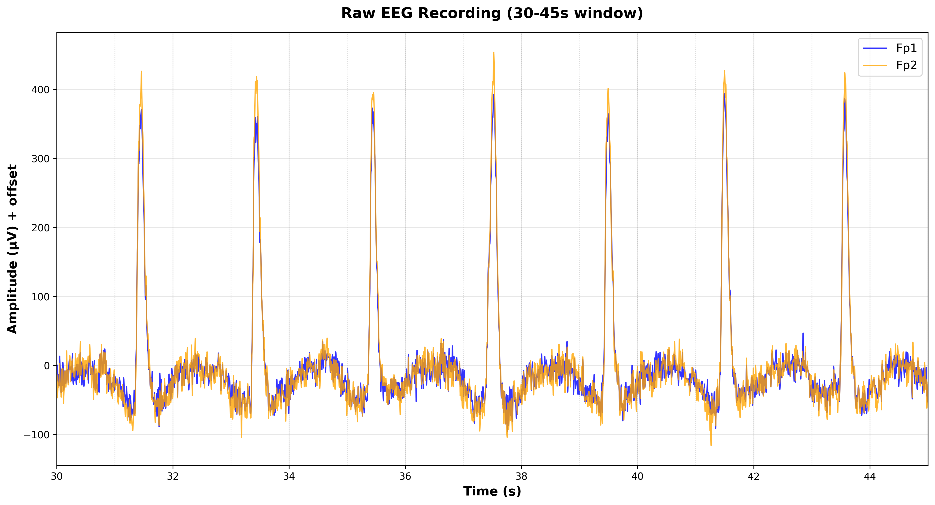
Preliminary Results

Slide 7
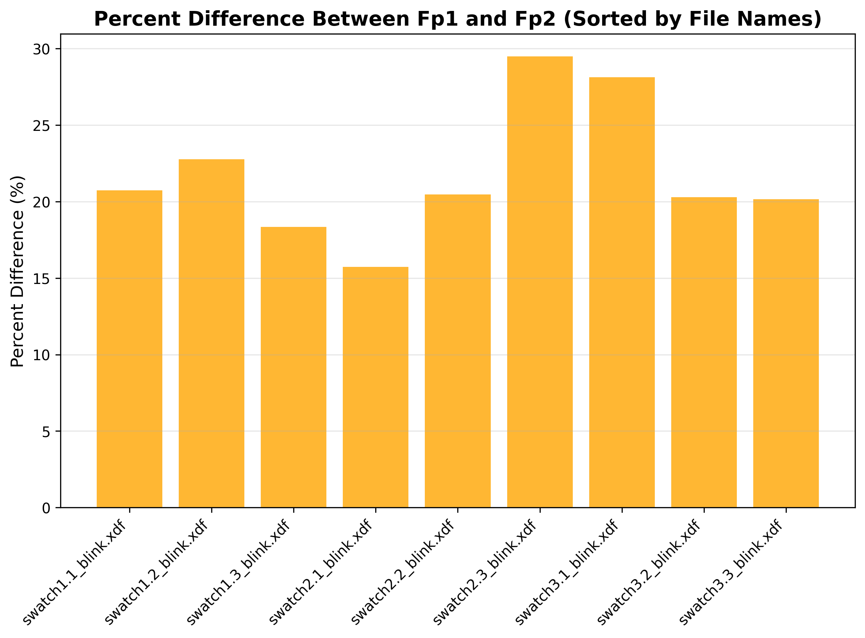
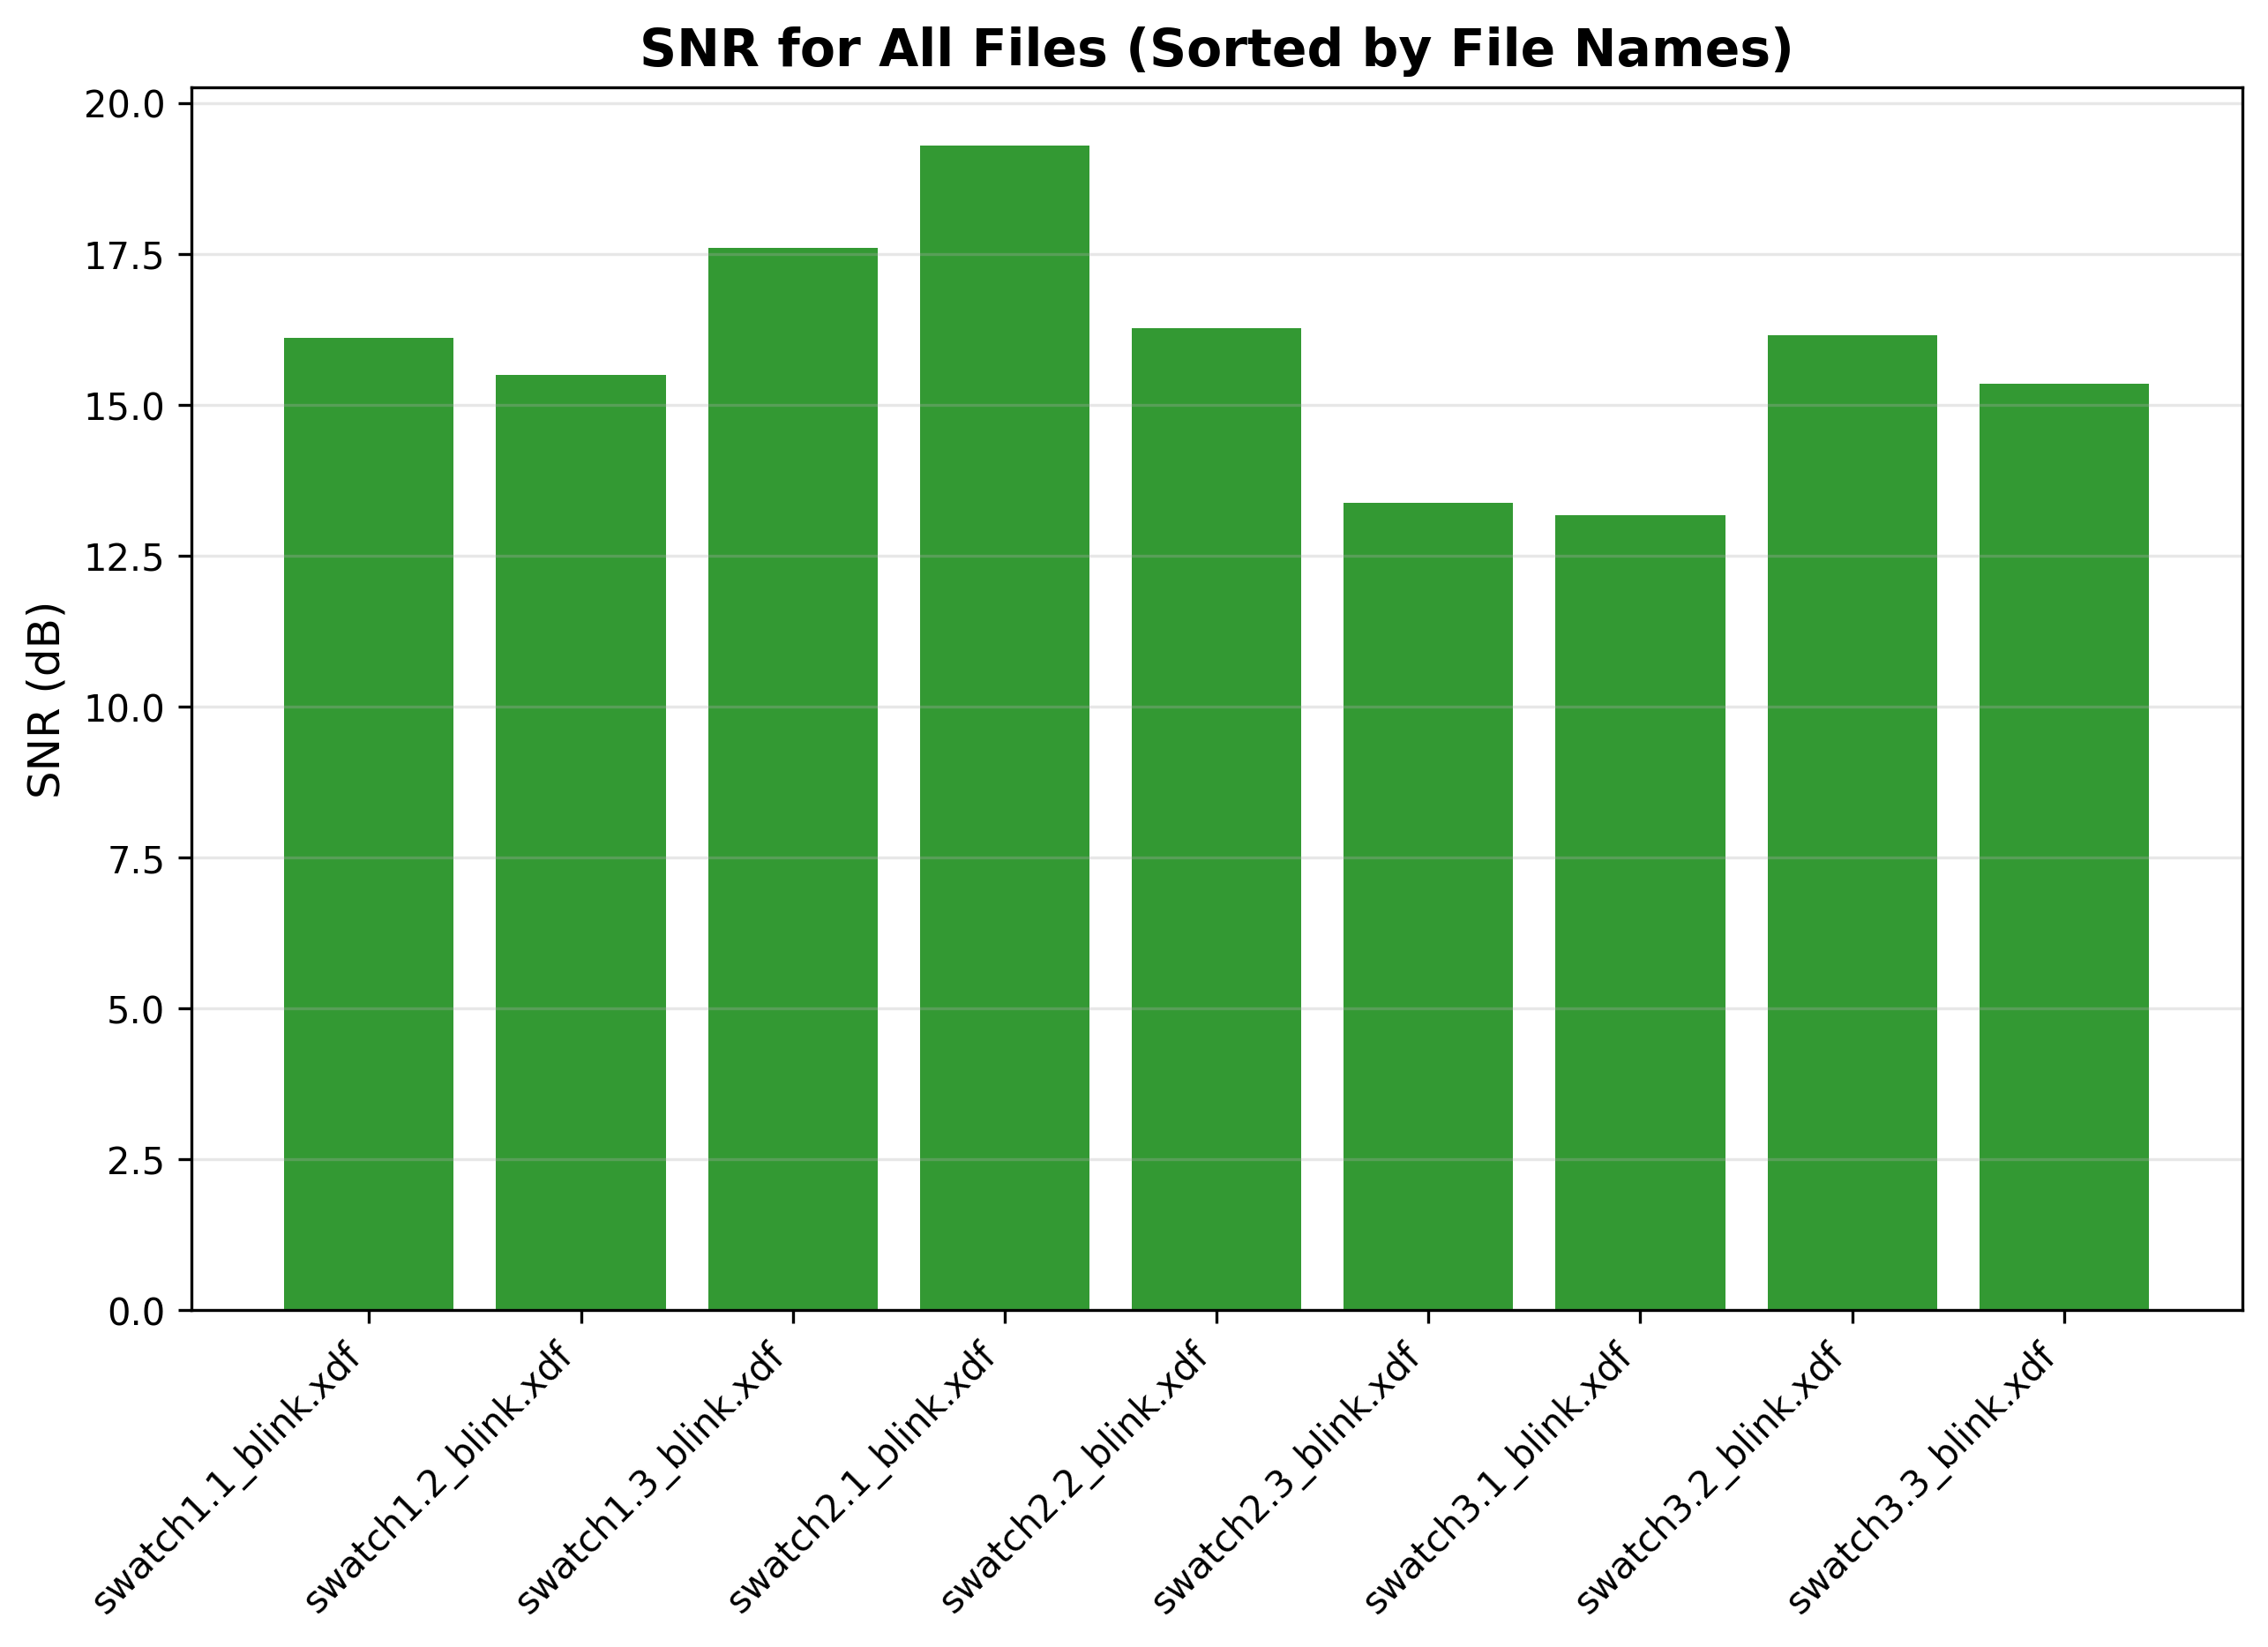
Preliminary Results
Notes:
Takes the entire raw EEG signal for each channel
Calculates the Root Mean Square (RMS): √(mean of squared values)
Converts from Volts to microvolts (×10⁶)
This represents the total signal power across all frequencies
Applies a high-pass filter at 30 Hz to isolate high-frequency content
The rationale: EEG signals of interest (Delta, Theta, Alpha, Beta) are typically below 30 Hz
Content above 30 Hz is assumed to be primarily muscle artifacts, electrical noise, and environmental interference
Calculates RMS of this filtered signal as the noise floor estimate

Slide 8
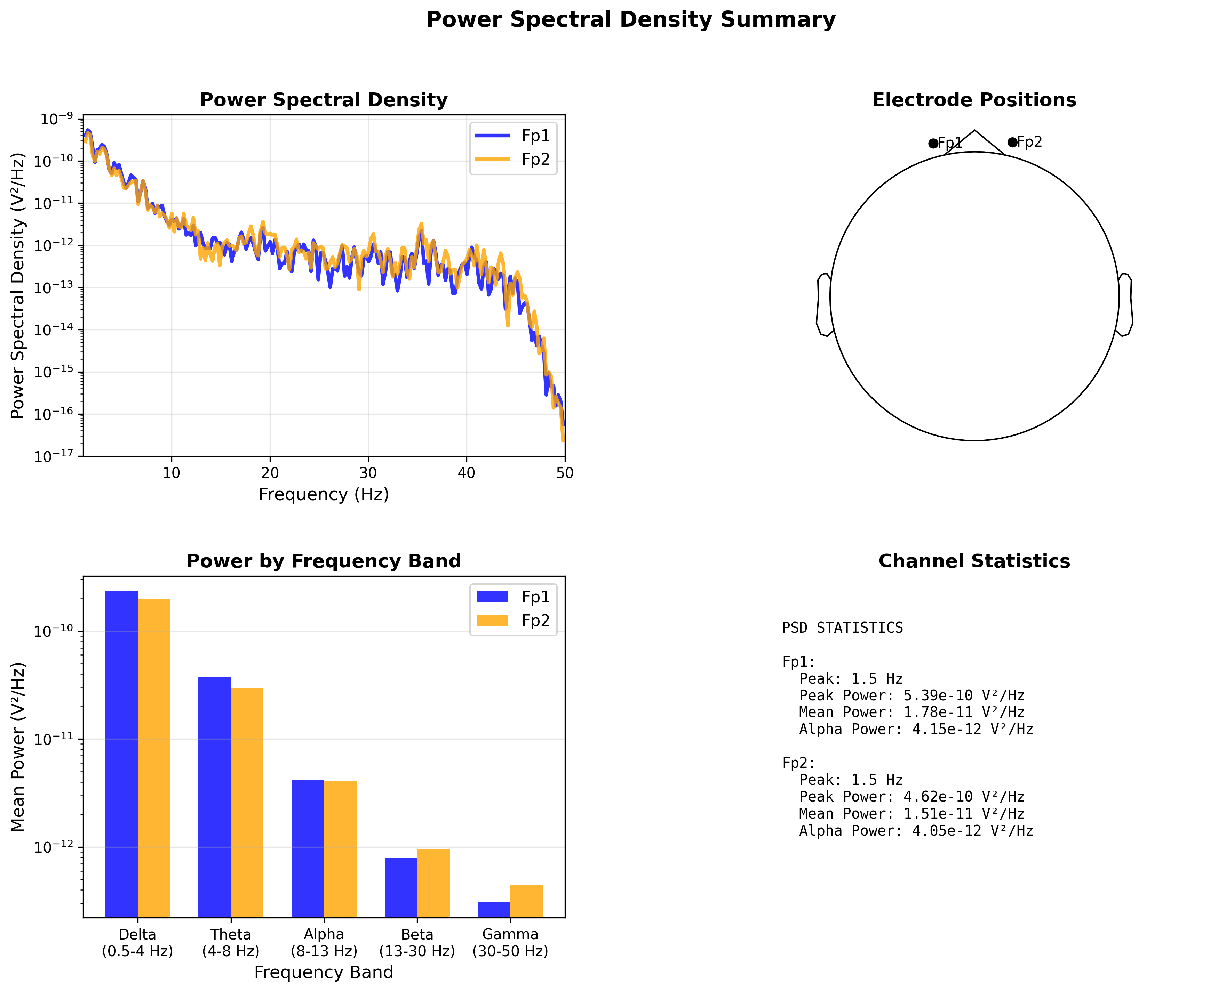
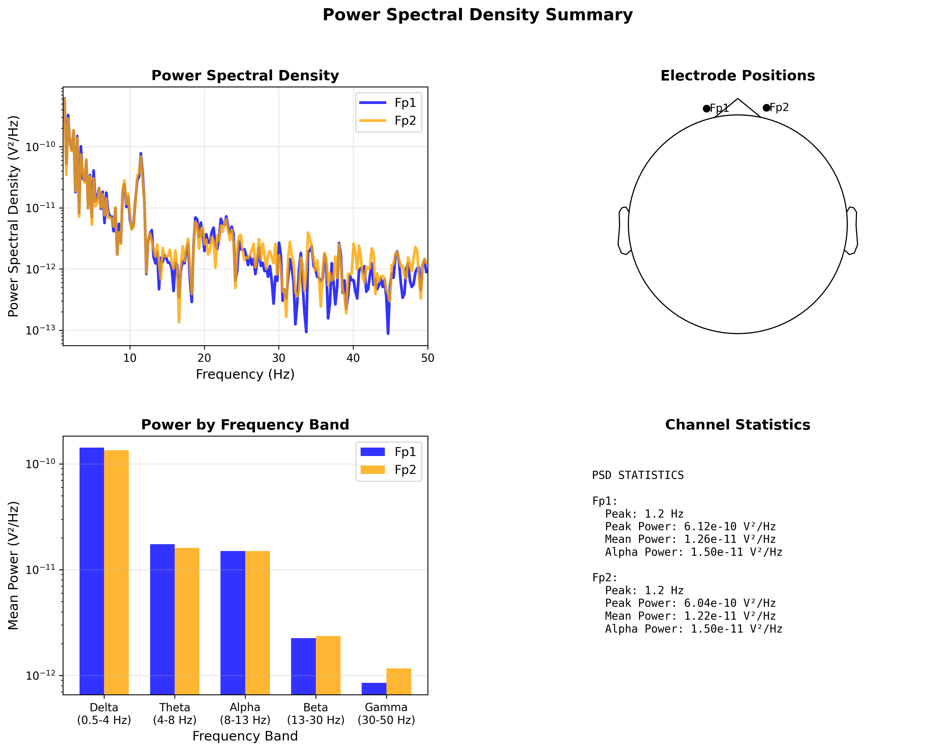
Preliminary Results

Slide 9
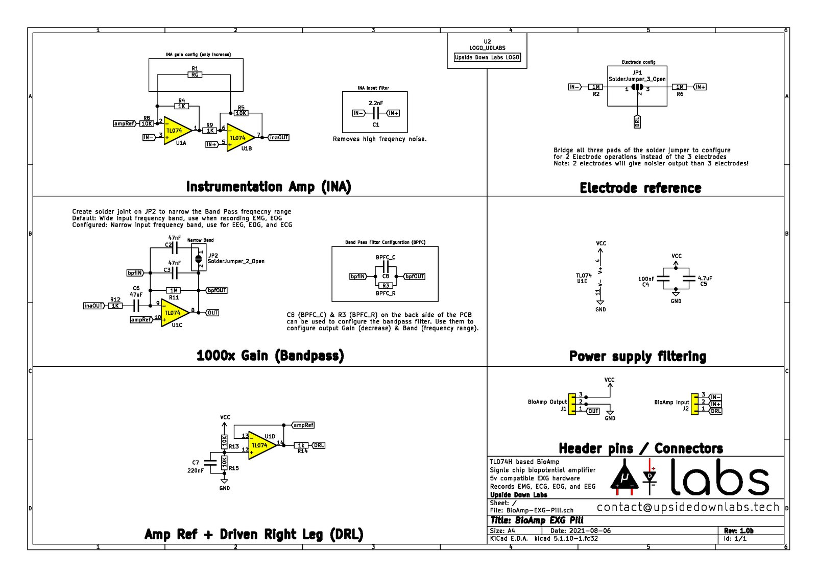
Next Steps
Pre-amplifier design
High-input impedance: 10^12 Ohms
Configurable gain: Set using SMD resistor
Band-pass filter: Set using SMD resistors for high-pass/low-pass cutoffs
Common-mode noise rejection
Operating voltage around 3.3-5V
Requires ADC (ADS1299x)
Notes:
BioAmp EXG Pill
Open Source: Both hardware and example software freely available.
Core Amplifier and Front-End Characteristics
While the detailed schematic is in the open-source files, the BioAmp EXG Pill embeds a biopotential instrumentation amplifier and configurable filtering components which are typical of EEG preamplifier design:
Input and Conditioning
High input impedance: ~10^12 Ω, which is critical to avoid loading the microvolt-level EEG signals. Upside Down Labs Docs
Electrode configuration: Supports standard 3-electrode differential measurements (active, reference, ground). Upside Down Labs Docs
Bias and reference options: Electrode pads can be bridged to support 2-electrode modes (less ideal for EEG due to reference issues). Upside Down Labs Docs
High input impedance and differential measurement are foundational to minimizing signal attenuation and common-mode artifact pickup in EEG preamplifiers.
Gain and Filtering
Configurable gain: Set by surface-mount resistor (R6) choice on the instrumentation amplifier. Upside Down Labs Docs
Band-pass filter: Configurable with discrete components (e.g., R12, C5) to tailor high-pass and low-pass cutoffs. Upside Down Labs Docs
Default configuration is optimized for EEG/EOG frequency ranges (~0.5–30 Hz). Crowd Supply
Users can modify filter components to shift band limits if targeting other biopotentials (EMG, ECG). Upside Down Labs Docs
Noise rejection: Designed to reject mains and environmental noise through hardware filtering and amplifier design. Crowd Supply
This structure reflects a typical first amplification stage plus a band-limited pass that centers the EEG frequency content while attenuating out-of-band noise before digitization.

Slide 10
Timeline
Interim Report – January 12th
Pre-amplifier component selection/testing – End of January/Start of February
Testing with prototype board against wet electrode system – Mid February/March
Thesis/Presentation – April

